Slide 1

Blockchain-Based Patient Data Management System
Under the supervision of
Dr. Dinesh K. Vishwakarma
Divya Kuntal
2K21/ISY/08

Slide 2
three major problem
Most sensitive data.
Everything is centralized in healthcare system
Data can be temper easily
Privacy

Slide 3
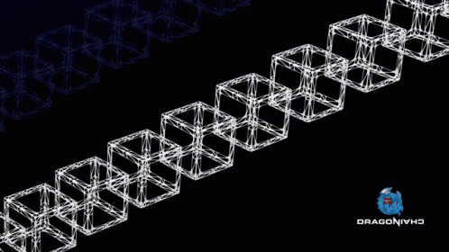
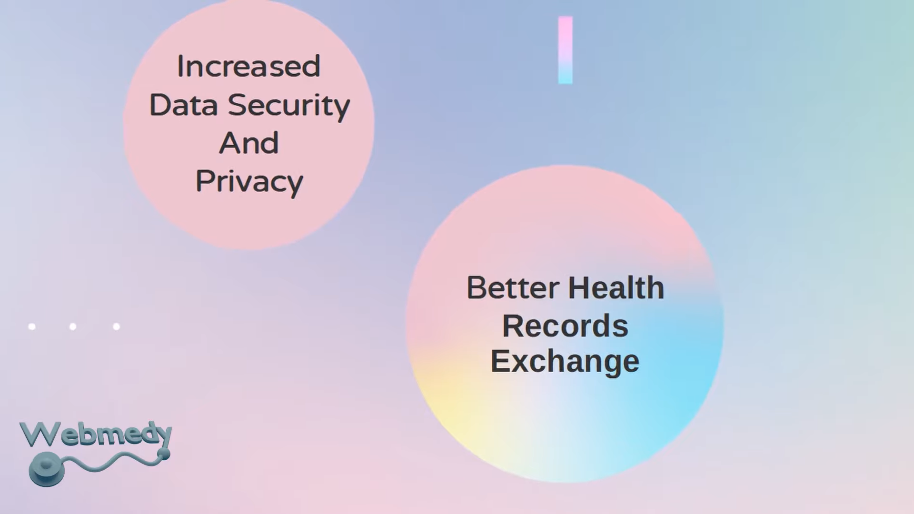
Through blockchain we will build our decentralized healthcare system.
Secure
Decentralized
immutable

Slide 4
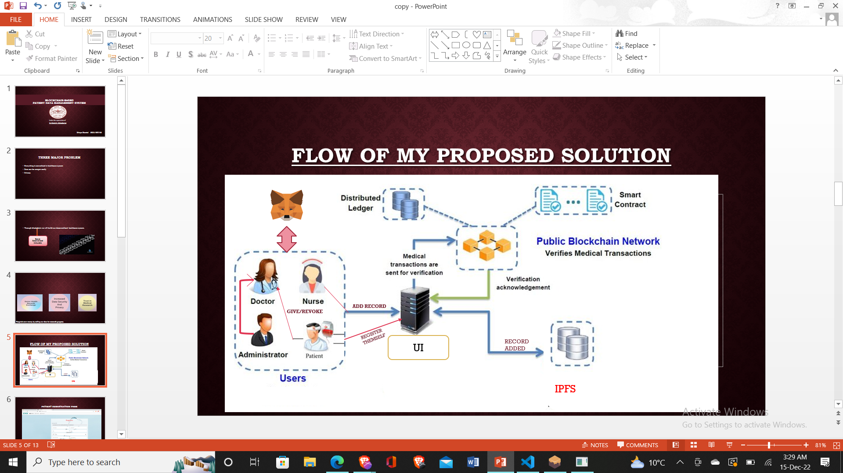
Flow of the project

Slide 5
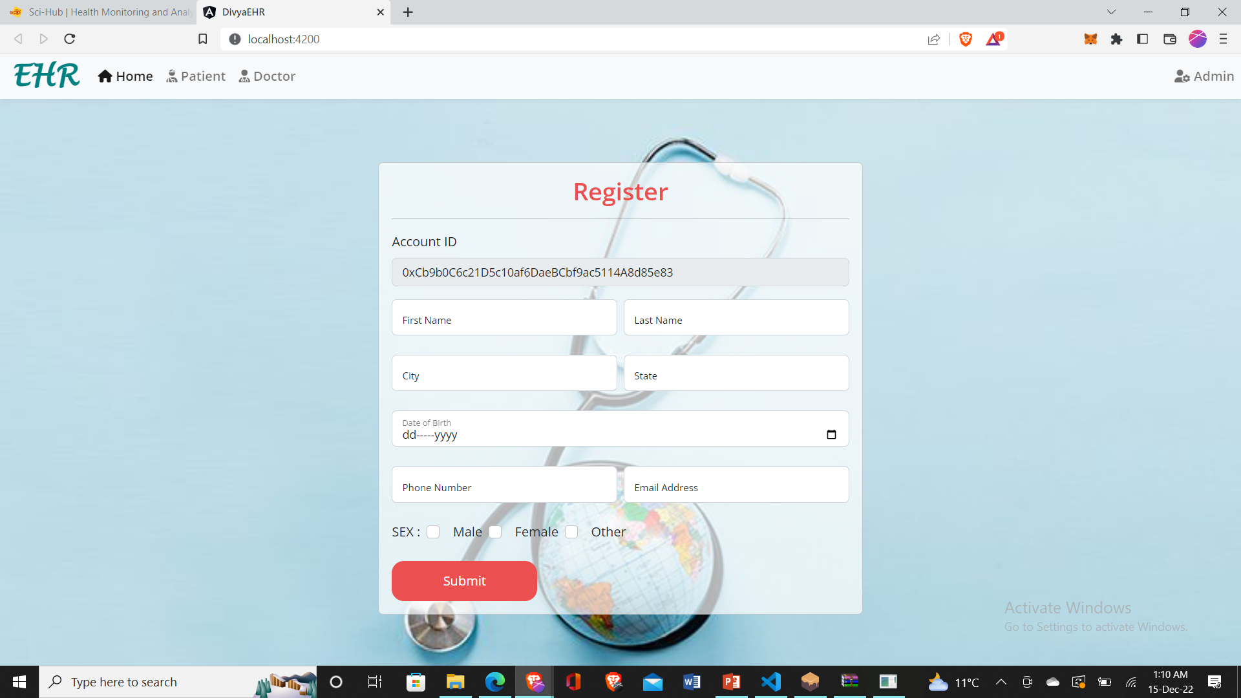
patient Registration page

Slide 6
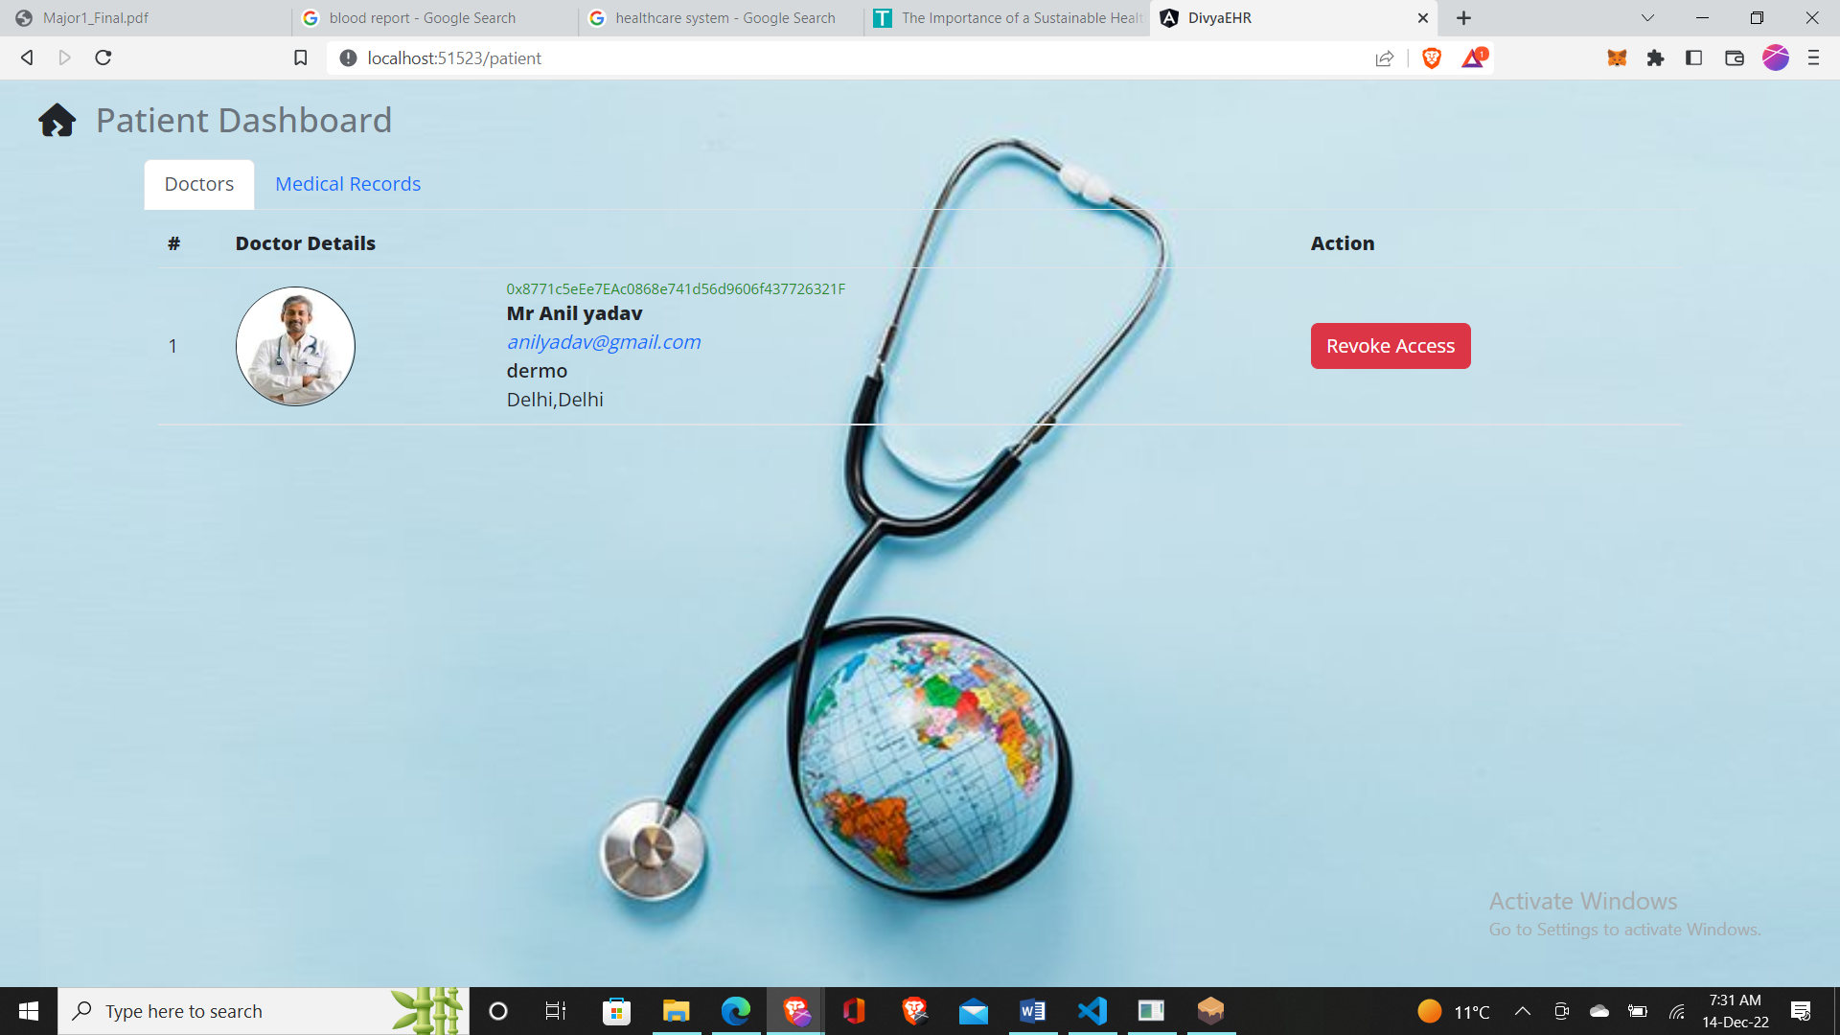
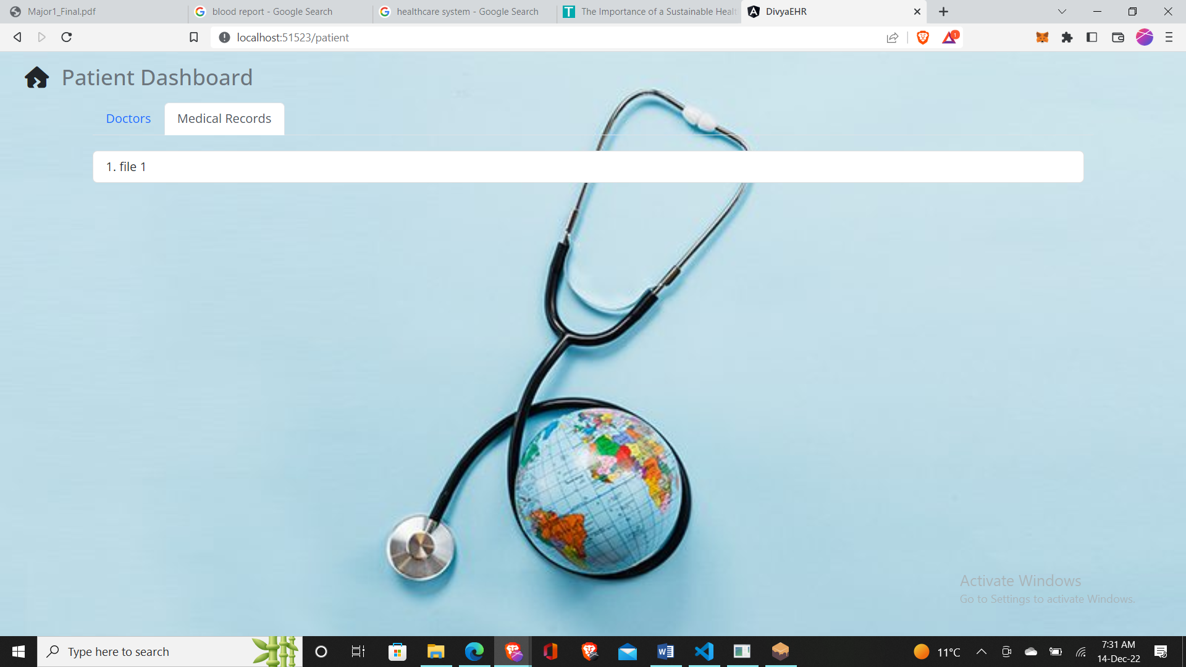
Patient Panel

Slide 7
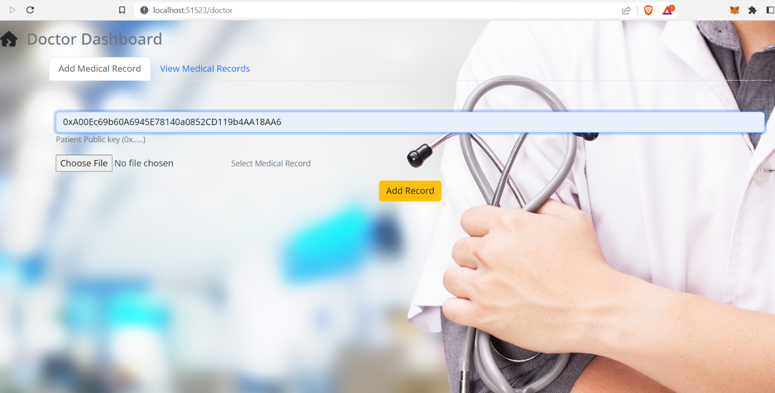
Doctor Panel

Slide 8
Limitation in existing work
Scalability : In Existing work they store their on the blockchain eg: Medicalchain,etc.
Secured Storage.
private Blockchain eg:Action-Ehr

Slide 9
Future Work
And give time limit access for other healthcare providers.
Insurance.
Payment option and appointment option.
Deployed on polygon for speed.
MultiChain(Bridge) deployment for Different organization.

Slide 10
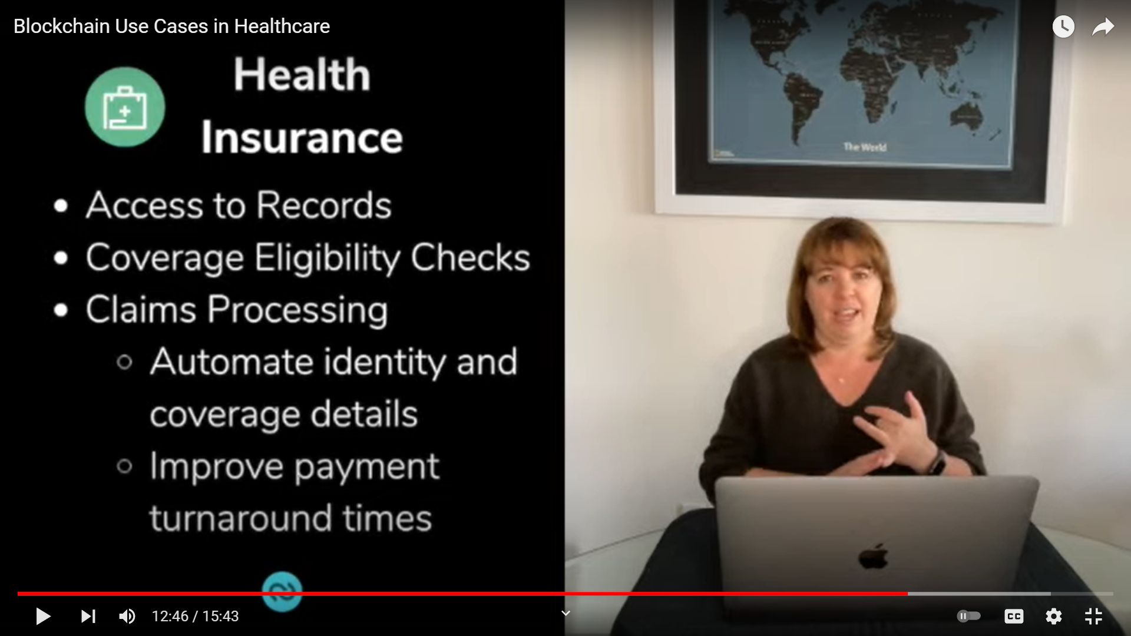
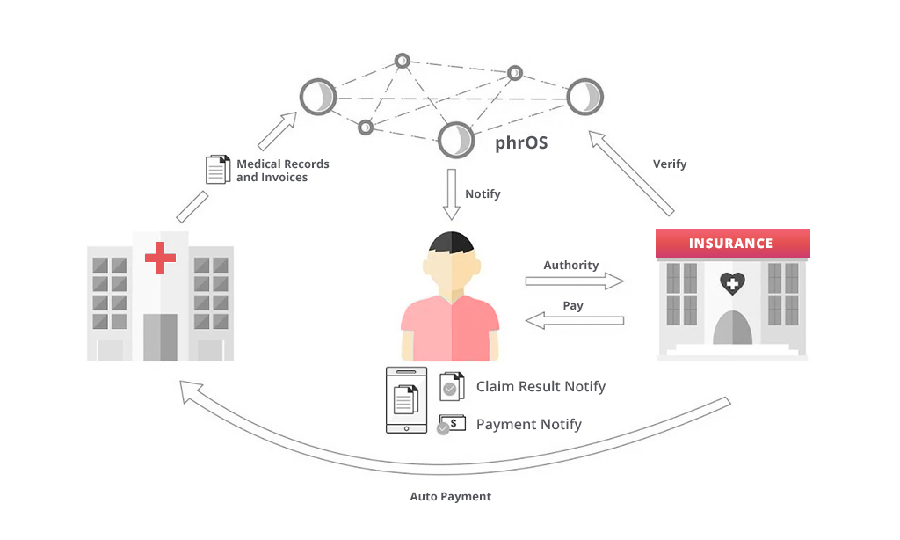

Slide 11
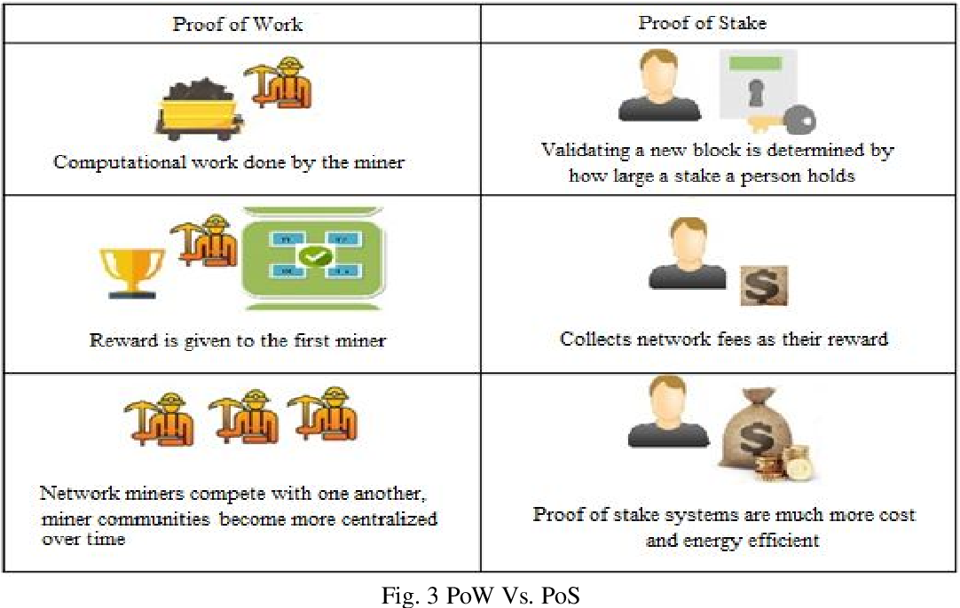
Pow vs pos

Slide 12


